Slide 1
Victorian Government Online Reporting and Assurance Platform
Multi-Factor Authentication (MFA) Setup

Slide 2
I acknowledge the Traditional Owners of the land on which we are meeting. I pay my respects to their Elders, past and present, and the Aboriginal Elders of other communities who may be here today.
Notes:
I acknowledge the Traditional Owners of the land on which we are meeting. I pay my respects to their Elders, past and present, and the Aboriginal Elders of other communities who may be here today.

Slide 3
Step I
Download the authentication app

Slide 4





Recommended Apps
Google Authenticator
Microsoft Authenticator
Okta Verify Authenticator
On your smart phone, navigate to App Store or
Google Play
Download and install one of the recommended apps.

Slide 5
Step II
Setting up the authentication app

Slide 6
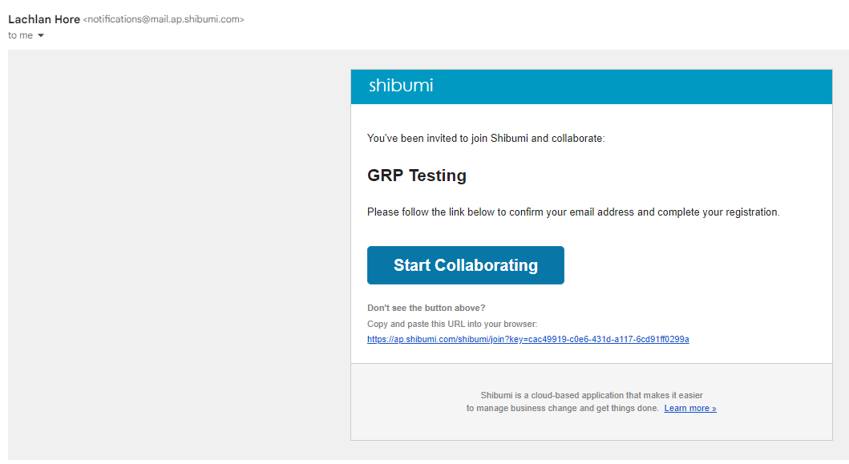
Click on the
Start Collaborating link in the email you receive.
It will take you to the Shibumi platform registration page.

Slide 7
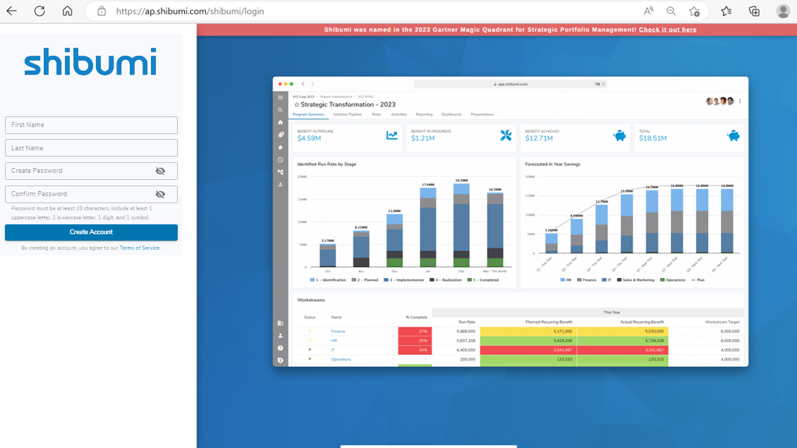
Provide the details and create your password

Slide 8
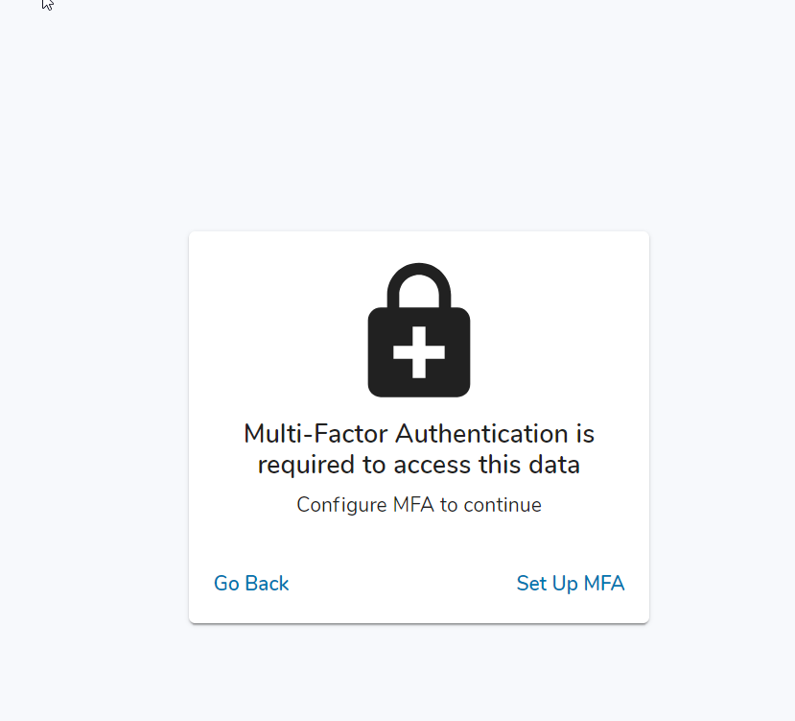
You will be prompted to setup authentication app.
Please click on the Set Up MFA link.

Slide 9
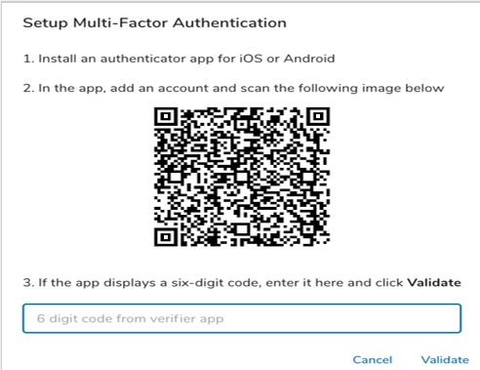
Open the authentication app downloaded earlier
Scan the QR code on your web browser from the app
Add the 6-digit code from the app and click on “Validate”
Once validated, your MFA setup is complete

Slide 10
Step III
Accessing your candidate profile

Slide 11
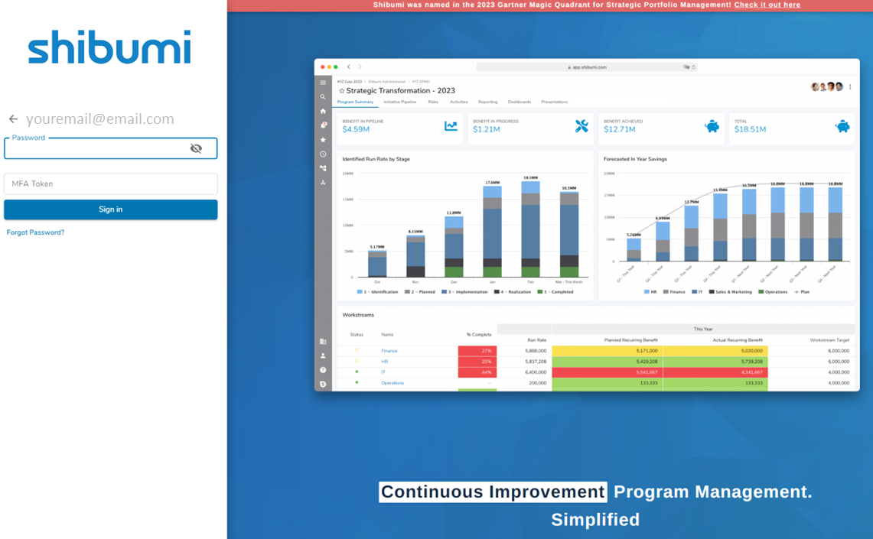
Once set up, enter your password
Enter the MFA code from the authentication app to login

Slide 12
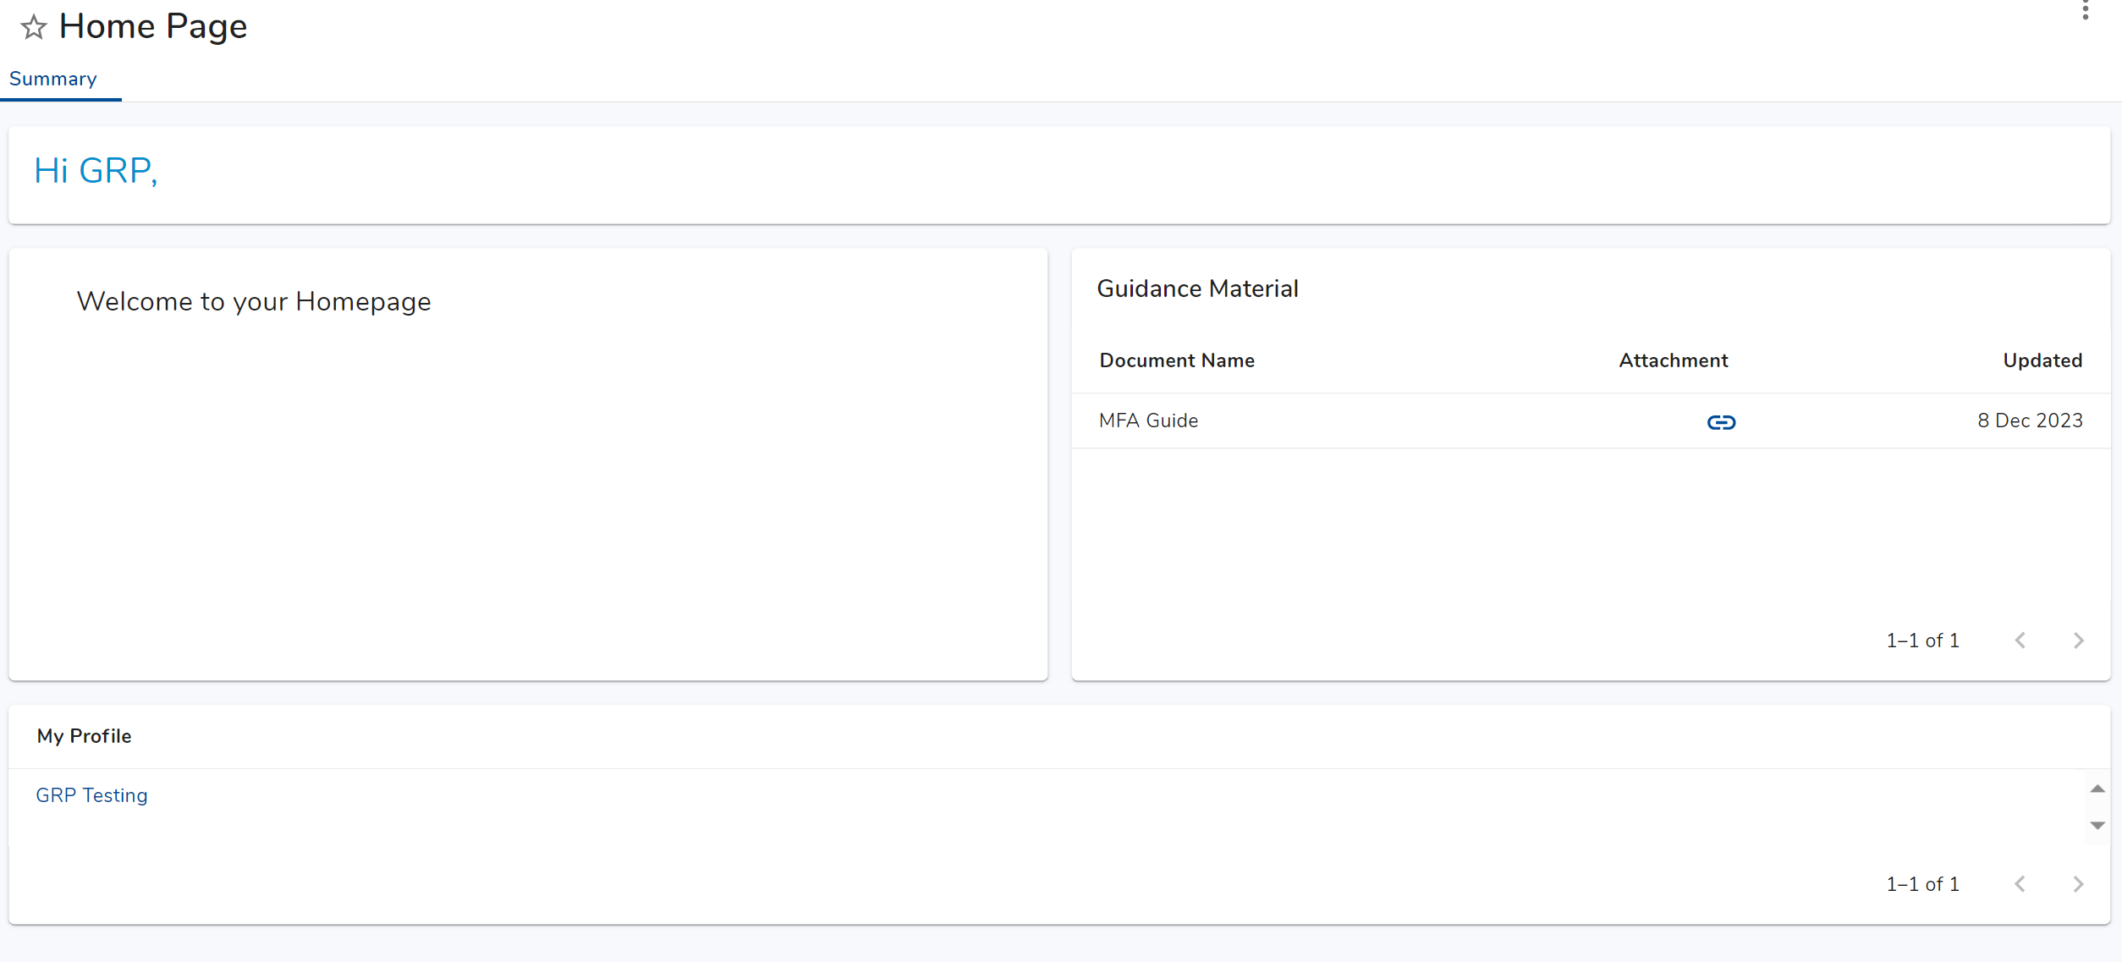
Click on your name under “My Profile” to access your candidate profile

Slide 13
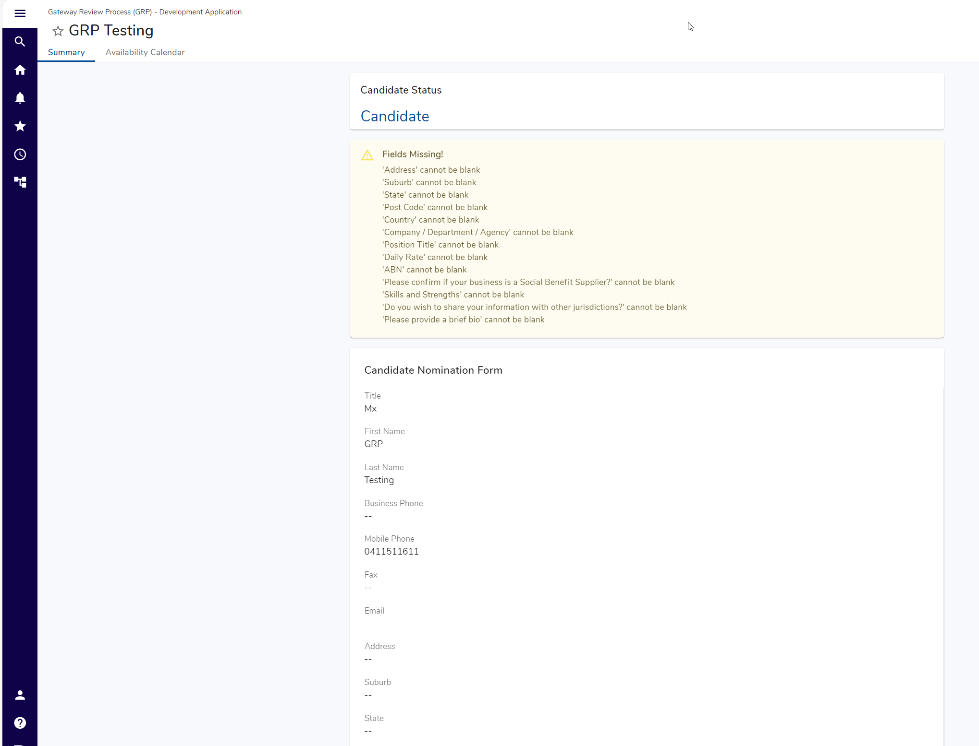
You are now able to view and edit your profile.

